Slide 1
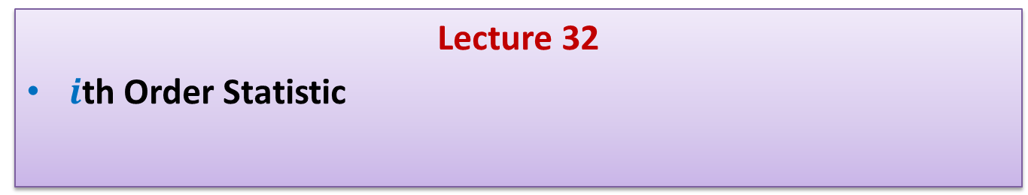
Data Structures and Algorithms (ESO207A)
Lecture 32
$i$th Order Statistic

Slide 2

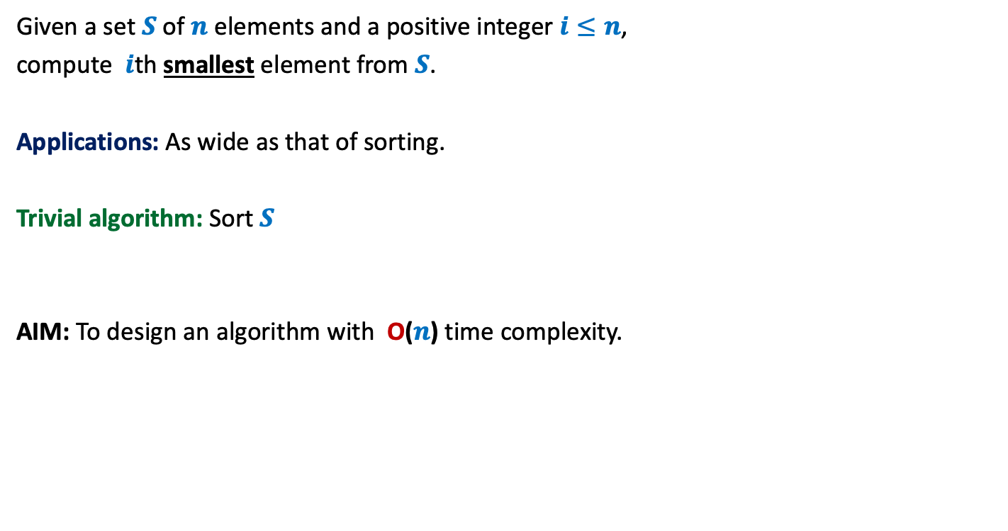

Problem definition
Given a set $S$of $n$ elements and a positive integer $i≤n$,
compute $i$th smallest element from $S$.
Applications: As wide as that of sorting.
Trivial algorithm: Sort $S$
AIM: To design an algorithm with O($n$) time complexity.
But sorting takes O(n log n) time
and appears to be an overkill
for this simple problem.
$$1945$$
$$1972$$

Slide 3
Notations
We shall now introduce some notations which will help in a neat description of the algorithm.

Slide 4
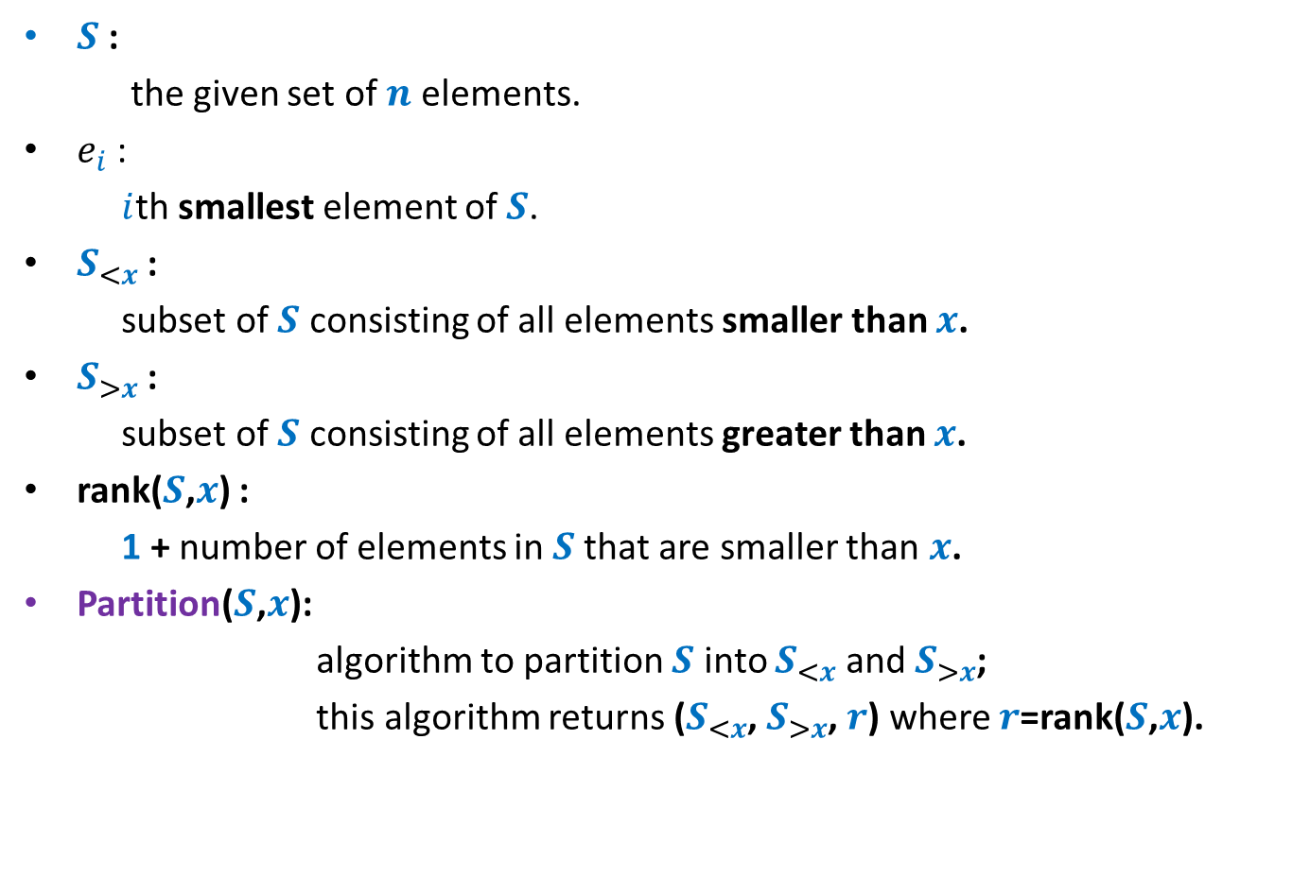
Notations
$S$ :
the given set of $n$ elements.
$e_{i}$ :
$i$th smallest element of $S$.
$S_{<x}$ :
subset of $S$ consisting of all elements smaller than $x$.
$S_{>x}$ :
subset of $S$ consisting of all elements greater than $x$.
rank($S$,$x$) :
1 + number of elements in $S$that are smaller than $x$.
Partition($S$,$x$):
algorithm to partition $S$ into $S_{<x}$ and $S_{>x}$;
this algorithm returns ($S_{<x}$, $S_{>x}$, $r$) where $r$=rank($S$,$x$).

Slide 5

Why should an O($n$) time algorithm exist ?
(inspiration from QuickSort)

Slide 6
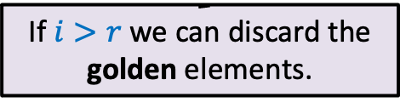





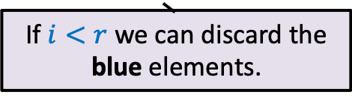
QuickSelect($S$,$i$)
0 1 2 3 4 5 6 7 8
> $e_{r}$
$$S$$
< $e_{r}$
$$e_{r}$$
If $i>r$ we can discard the golden elements.
If $i<r$ we can discard the blue elements.

Slide 7
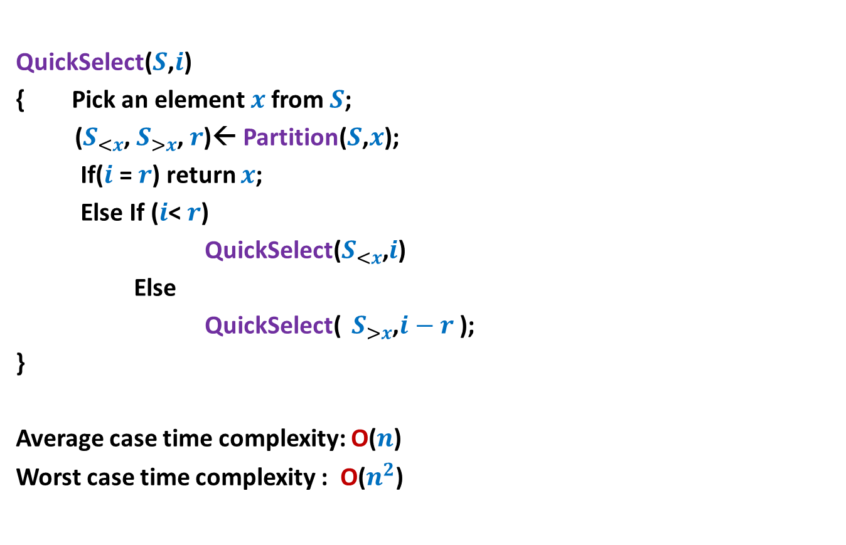
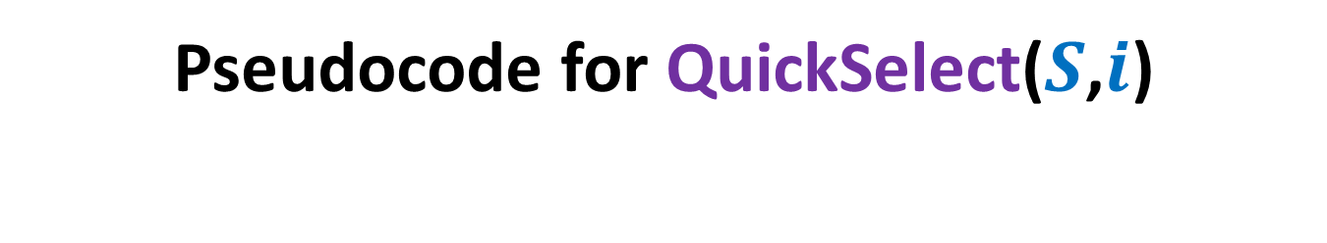
Pseudocode for QuickSelect($S$,$i$)
QuickSelect($S$,$i$)
{ Pick an element $x$from $S$;
($S_{<x}$, $S_{>x}$, $r$)← Partition($S$,$x$);
If($i$ = $r$) return $x$;
Else If ($i$< $r$)
QuickSelect($S_{<x}$,$i$)
Else
QuickSelect( $S_{>x}$,$i−r$ );
}
Average case time complexity: O($n$)
Worst case time complexity : O($n^{2}$)
Analysis is simpler than Quick Sort.

Slide 8

Towards worst case O($n$) time algorithm …

Slide 9

Key ideas
Inspiration from some recurrences.
Concept of approximate median
Learning from QuickSelect($S$,$i$)
isn’t is surprising that knowledge of recurrence
can help in the design an efficient algorithm) ☺
This is the usual trick:
When a problem appears difficult, weaken the problem and try to solve it.
This is also a natural choice.
Can we fine tune this algorithm to achieve our goal ?

Slide 10

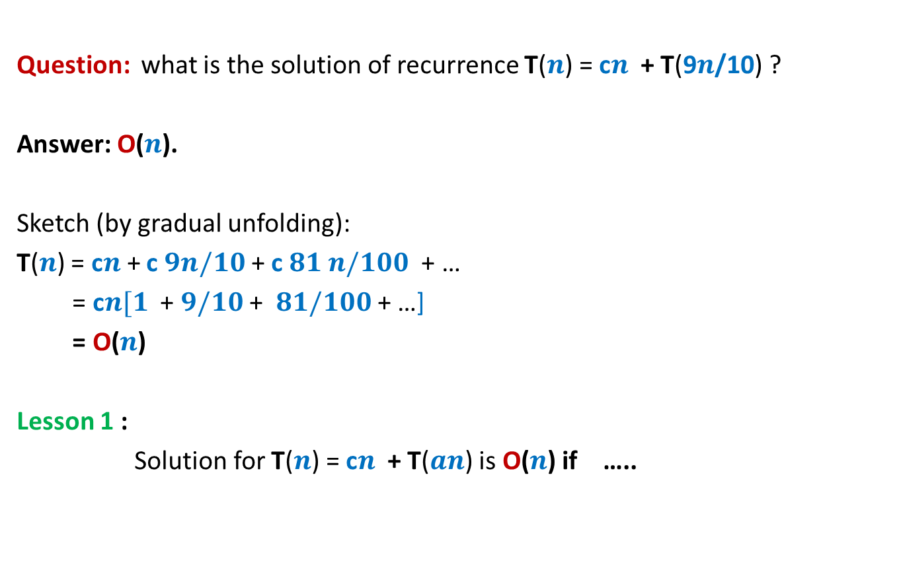
Revisiting Recurrences
Question: what is the solution of recurrence T($n$) = c$n$ + T(9$n$/10) ?
Answer: O($n$).
Sketch (by gradual unfolding):
T($n$) = c$n$+ c $9n/10$ + c $81 n/100$ + …
= c$n[1$ + $9/10$ + $81/100$ + …]
= O($n$)
Lesson 1 :
Solution for T($n$) = c$n$ + T($an$) is O($n$) if …..
$0<a<1$.

Slide 11

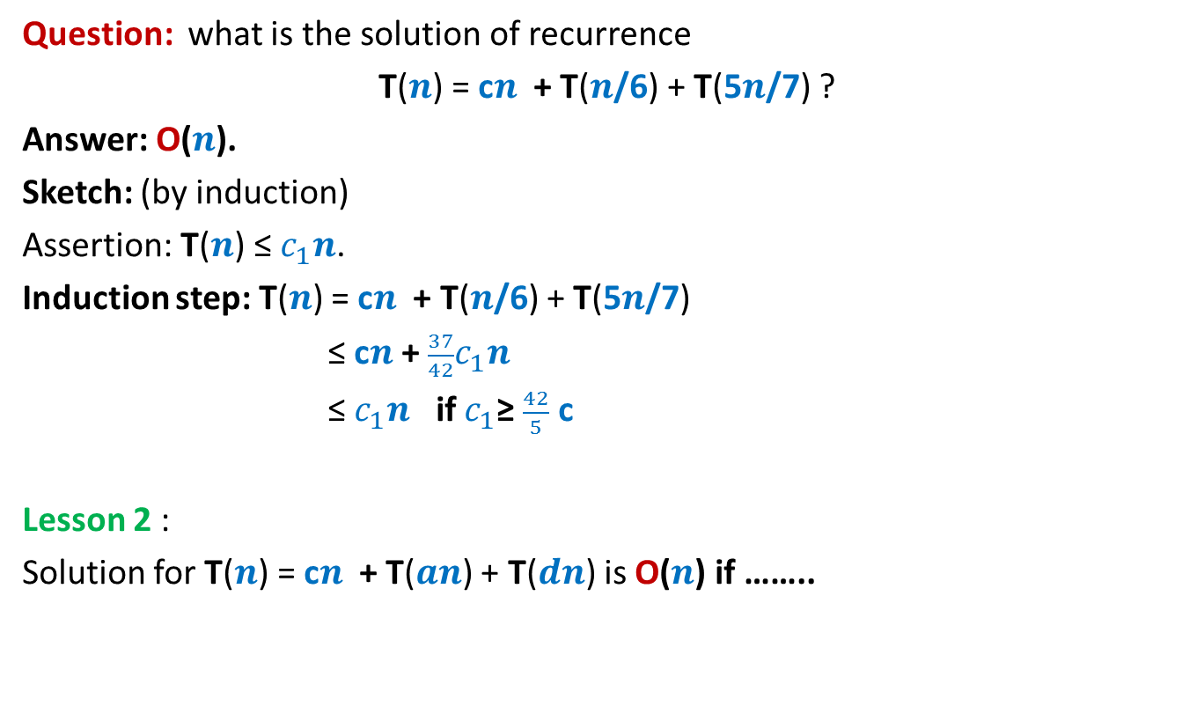
Revisiting recurrences
Question: what is the solution of recurrence
T($n$) = c$n$ + T($n$/6) + T(5$n$/7) ?
Answer: O($n$).
Sketch: (by induction)
Assertion: T($n$) ≤ $c_{1}n$.
Induction step: T($n$) = c$n$ + T($n$/6) + T(5$n$/7)
≤ c$n$ + $\frac{37}{42}c_{1}n$
≤ $c_{1}n$ if $c_{1}$≥ $\frac{42}{5}$ c
Lesson 2 :
Solution for T($n$) = c$n$ + T($an$) + T($dn$) is O($n$) if ……..
$a+d<1$.

Slide 12







Concept of approximate median
Definition: Given a constant $0<b≤1/2$,
an element $x$ ϵ $S$ is said to be $b$-approximate median of $S$
if rank($x,S$) is in the range [$bn$, ($1−b$)$n$].
$$e_{1}$$
$$e_{2}$$
$$e_{bn}$$
$$x$$
$$e_{(1−b)n}$$
$$e_{n}$$

Slide 13
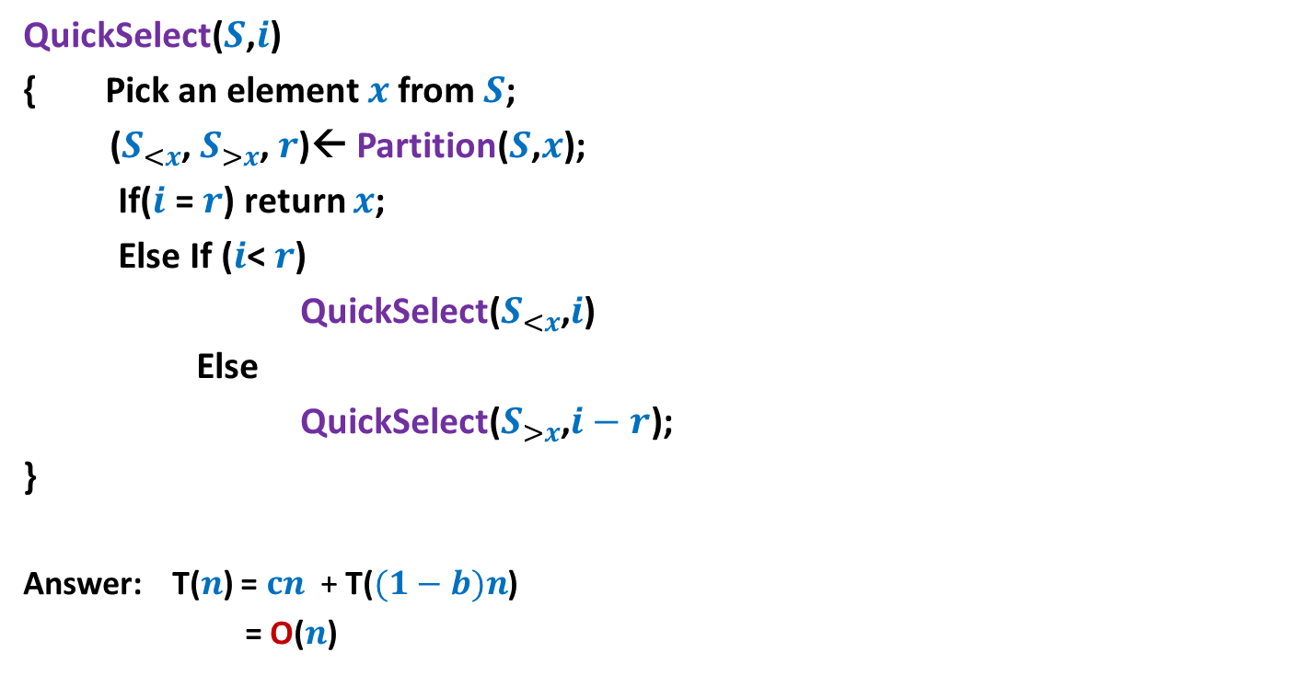



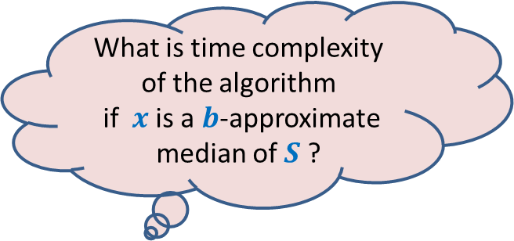
Learning from QuickSelect($S$,$i$)
QuickSelect($S$,$i$)
{ Pick an element $x$from $S$;
($S_{<x}$, $S_{>x}$, $r$)← Partition($S$,$x$);
If($i$ = $r$) return $x$;
Else If ($i$< $r$)
QuickSelect($S_{<x}$,$i$)
Else
QuickSelect($S_{>x}$,$i−r$);
}
Answer: T($n$) = $cn$ + T($(1−b)n$)
= O($n$)
O($n$)
T( $(1−b)n$)
What is time complexity of the algorithm
if $x$ is a $b$-approximate median of $S$ ?
Lesson 1

Slide 14
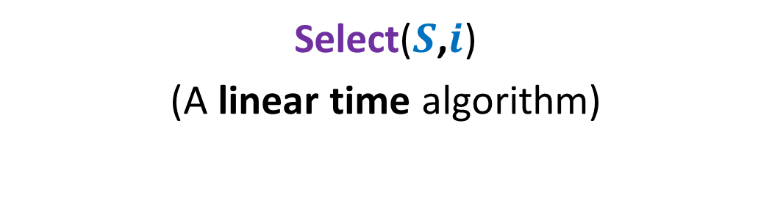
Algorithm 2
Select($S$,$i$)
(A linear time algorithm)

Slide 15

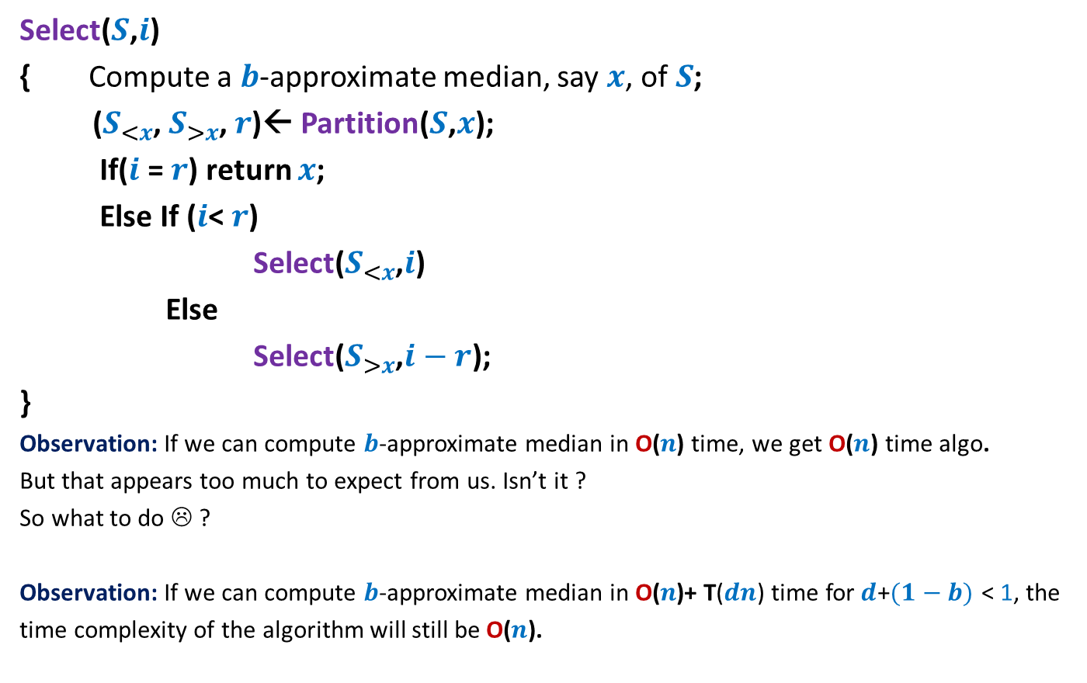


Overview of the algorithm
Select($S$,$i$)
{ Compute a $b$-approximate median, say $x$, of$S$;
($S_{<x}$, $S_{>x}$, $r$)← Partition($S$,$x$);
If($i$ = $r$) return $x$;
Else If ($i$< $r$)
Select($S_{<x}$,$i$)
Else
Select($S_{>x}$,$i−r$);
}
Observation: If we can compute $b$-approximate median in O($n\text{)}$ time, we get O($n$) time algo.
But that appears too much to expect from us. Isn’t it ?
So what to do ☹ ?
Observation: If we can compute $b$-approximate median in O($n\text{)+} \text{T}\text{(}dn\text{)}$time for$d$+$(1−b)$ < 1, the
time complexity of the algorithm will still be O($n$).
O($n\text{) +} \text{T}\text{(}dn\text{)}$
O($n$)
T( $(1−b)n$)
Hint: use Lesson 2
Spend some time on this observation to infer what it hints at.

Slide 16


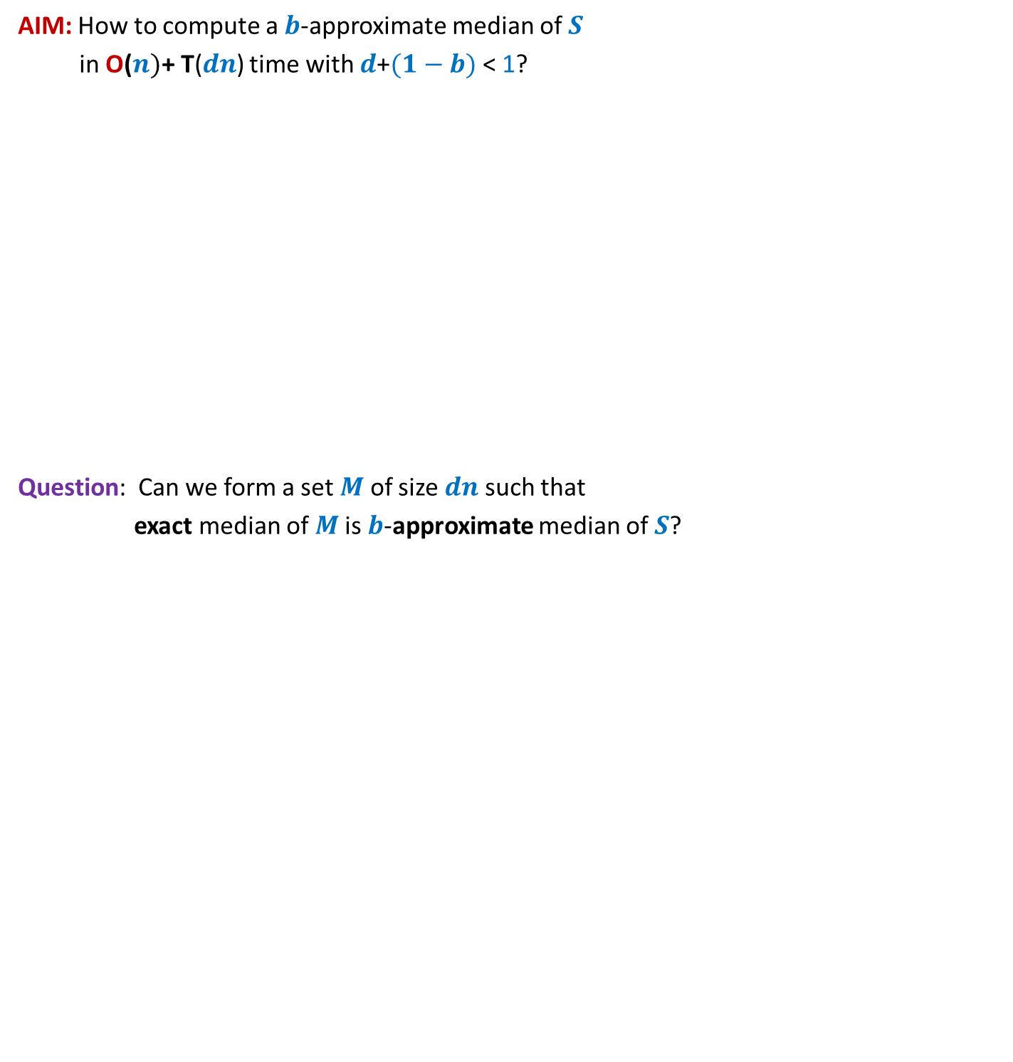


AIM: How to compute a $b$-approximate median of $S$
in O($n)\text{+} \text{T}\text{(}dn\text{)}$ time with $d$+$(1−b)$ < 1?
Question: Can we form a set $M$ of size $dn$such that
exact median of $M$is $b$-approximate median of $S$?
$$S$$
$$M$$

Slide 17
Homework
Ponder over how to achieve the aim mentioned in the previous slide.

Slide 18



Lessons from recurrences
Lesson 1 :
Solution for T($n$) = c$n$ + T($an$) is O($n$) if …..
Lesson 2 :
Solution for T($n$) = c$n$ + T($an$) + T($dn$) is O($n$) if ……..
$0<a<1$.
$a+d<1$.

Slide 19
Learning from QuickSelect($S$,$i$)
QuickSelect($S$,$i$)
{ Pick an element $x$from $S$;
($S_{<x}$, $S_{>x}$, $r$)← Partition($S$,$x$);
If($i$ = $r$) return $x$;
Else If ($i$< $r$)
QuickSelect($S_{<x}$,$i$)
Else
QuickSelect($S_{>x}$,$i−r$);
}
Answer: T($n$) = $cn$ + T($(1−b)n$)
= O($n$)
O($n$)
T( $(1−b)n$)
What is time complexity of the algorithm
if $x$ is a $b$-approximate median of $S$ ?
Lesson 1

Slide 20
Algorithm 2
Select($S$,$i$)
(A linear time algorithm)

Slide 21
Overview of the algorithm
Select($S$,$i$)
{ Compute a $b$-approximate median, say $x$, of$S$;
($S_{<x}$, $S_{>x}$, $r$)← Partition($S$,$x$);
If($i$ = $r$) return $x$;
Else If ($i$< $r$)
Select($S_{<x}$,$i$)
Else
Select($S_{>x}$,$i−r$);
}
Observation: If we can compute $b$-approximate median in O($n\text{)}$ time, we get O($n$) time algo.
But that appears too much to expect from us. Isn’t it ?
So what to do ☹ ?
Observation: If we can compute $b$-approximate median in O($n\text{)+} \text{T}\text{(}dn\text{)}$time for$d$+$(1−b)$ < 1, the
time complexity of the algorithm will still be O($n$).
O($n\text{) +} \text{T}\text{(}dn\text{)}$
O($n$)
T( $(1−b)n$)
Hint: use Lesson 2
Spend some time on this observation to infer what it hints at.

Slide 22




AIM: How to compute a $b$-approximate median of $S$
in O($n)\text{+} \text{T}\text{(}dn\text{)}$ time with $d$+$(1−b)$ < 1?
Question: Can we form a set $M$ of size $dn$such that
exact median of $M$is $b$-approximate median of $S$?
$$S$$
$b$-approximate median
$$n$$
O($n)$ time
$$M$$
Median
$$dn$$
Homework in the last class

Slide 23
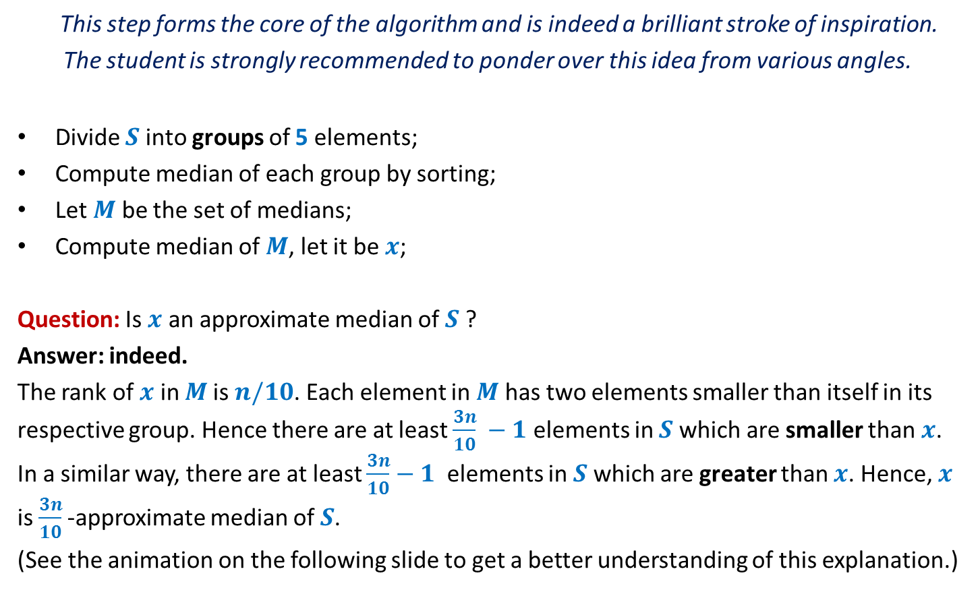



Forming the subset $M$ with desired parameters
This step forms the core of the algorithm and is indeed a brilliant stroke of inspiration.
The student is strongly recommended to ponder over this idea from various angles.
Divide $S$ into groups of 5 elements;
Compute median of each group by sorting;
Let $M$ be the set of medians;
Compute median of $M$, let it be $x$;
Question: Is $x$ an approximate median of $S$ ?
Answer: indeed.
The rank of $x$ in $M$is $n/10$. Each element in $M$ has two elements smaller than itself in its respective group. Hence there are at least $\frac{3n}{10} −1$ elements in $S$which are smaller than $x$. In a similar way, there are at least $\frac{3n}{10}−1$ elements in $S$which are greater than $x$. Hence, $x$ is $\frac{3n}{10}$-approximate median of $S$.
(See the animation on the following slide to get a better understanding of this explanation.)
O($n$)
$$\text{T}\text{(}n\text{/5}\text{)}$$

Slide 24






Forming the subset $M$
$$S$$
$$15 9 7 82 17 59 32 1 101 46 78 …$$
Divide $S$ into groups of 5 elements;
Compute median of each group by sorting;
$$M$$
$$15$$
$$46$$
1 2 … $\frac{n}{10}$ … $\frac{n}{5}$
O($n$)

Slide 25


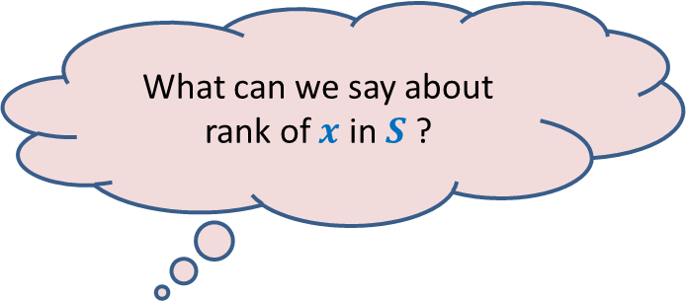
Forming the subset $M$
$$S$$
$$15 9 7 82 17 59 32 1 101 46 78 …$$
Divide $S$ into groups of 5 elements;
Compute median of each group by sorting;
Let $M$ be the set of medians;
Let $x$be median of $M$.
Spend some time to answer this question before moving ahead.
$$M$$
$$15$$
$$46$$
$$x$$
What can we say about rank of $x$ in $S$ ?

Slide 26



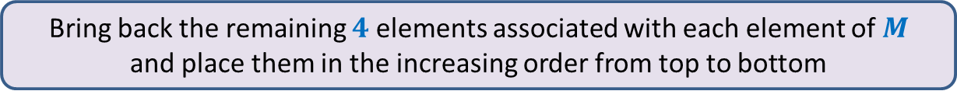




Forming the subset $M$
Bring back the remaining $4$ elements associated with each element of $M$
and place them in the increasing order from top to bottom
➔ $x$ is $\left(\frac{3n}{10}\right)−$approximate median of $S$.
Time required to form $M$ : O($n$)
Increasing order of values in $M$
Surely smaller than $x$
$$M$$
$$x$$
$$S$$
Surely greater than $x$
1 2 … $\frac{n}{10}$ … $\frac{n}{5}$

Slide 27
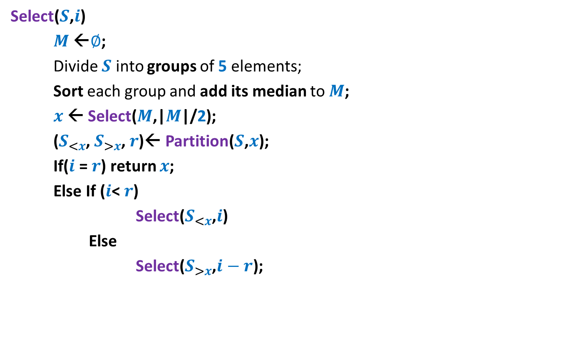

Pseudocode for Select($S$,$i$)
Select($S$,$i$)
$M$←$∅$;
Divide $S$ into groups of 5 elements;
Sort each group and add its median to $M$;
$x$← Select($M$,|$M$|/2);
($S_{<x}$, $S_{>x}$, $r$)← Partition($S$,$x$);
If($i$ = $r$) return $x$;
Else If ($i$< $r$)
Select($S_{<x}$,$i$)
Else
Select($S_{>x}$,$i−r$);
O(n)
T(n/5)
O(n)
T(7n/10)

Slide 28

Analysis
T(n) = cn + T(n/5) + T(7n/10)
= O(n) [Learning from Recurrence of type II]
Theorem: Given any $S$of n elements, we can compute ith smallest element from $S$ in O(n) worst case time.

Slide 29

Homework
What if we divide the set $S$ into groups of size
$3 ?$
$7 ?$
$4 ?$
$6 ?$

Slide 30
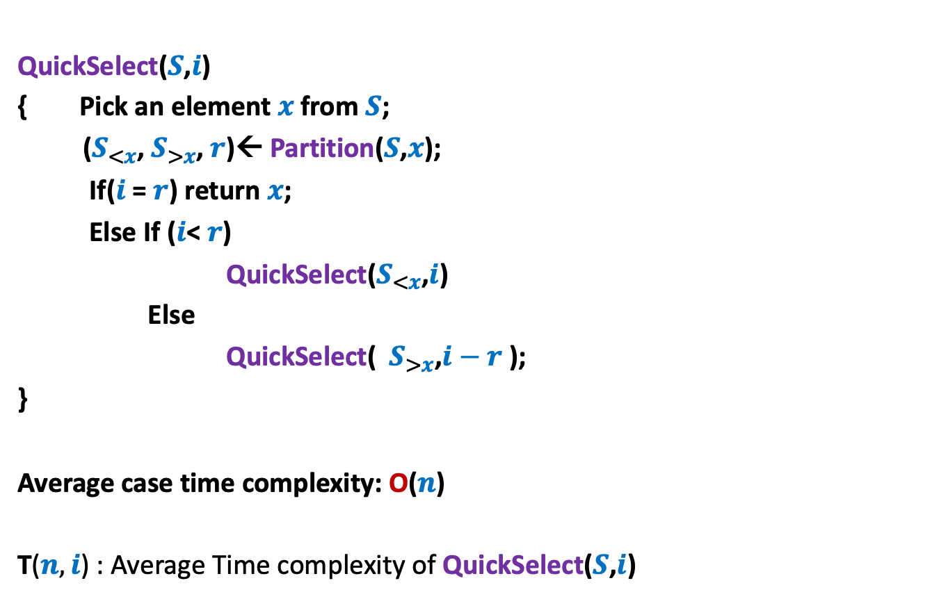
Homework from previous class
QuickSelect($S$,$i$)
{ Pick an element $x$from $S$;
($S_{<x}$, $S_{>x}$, $r$)← Partition($S$,$x$);
If($i$ = $r$) return $x$;
Else If ($i$< $r$)
QuickSelect($S_{<x}$,$i$)
Else
QuickSelect( $S_{>x}$,$i−r$ );
}
Average case time complexity: O($n$)
T($n,i$) : Average Time complexity of QuickSelect($S$,$i$)
Analysis is simpler than Quick Sort.

Slide 31
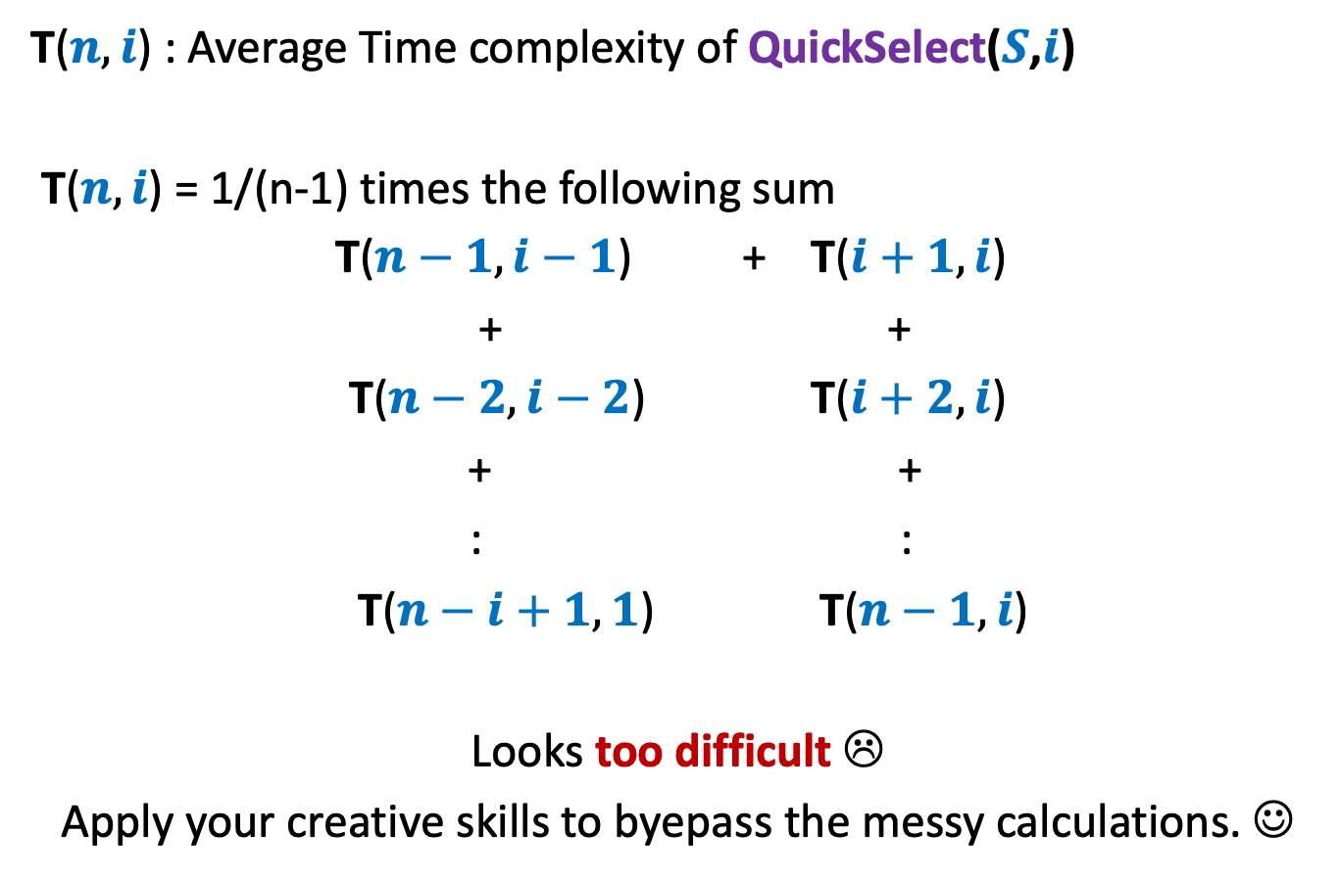
T($n,i$) : Average Time complexity of QuickSelect($S$,$i$)
T($n,i$) = 1/(n-1) times the following sum
T($n−1,i−1$) + T($i+1,i$)
+ +
T($n−2,i−2$) T($i+2,i$)
+ +
: :
T($n−i+1,1$) T($n−1,i$)
Looks too difficult ☹
Apply your creative skills to byepass the messy calculations. ☺

Slide 32
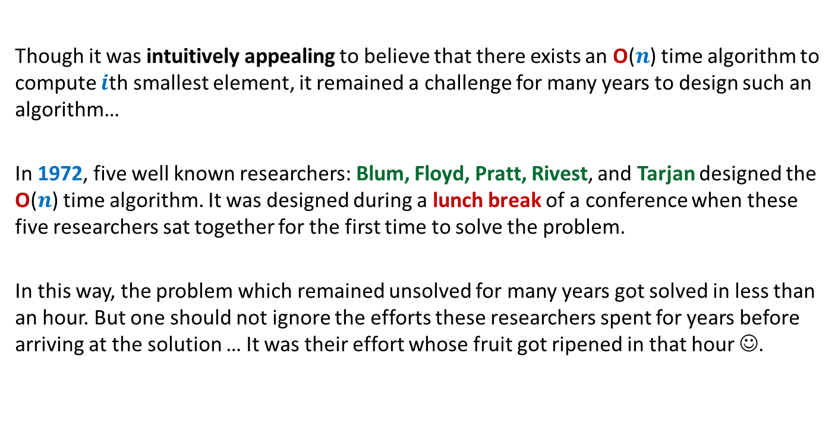
A motivational background
Though it was intuitively appealing to believe that there exists an O($n$) time algorithm to compute $i$th smallest element, it remained a challenge for many years to design such an algorithm…
In 1972, five well known researchers: Blum, Floyd, Pratt, Rivest, and Tarjan designed the O($n$) time algorithm. It was designed during a lunch break of a conference when these five researchers sat together for the first time to solve the problem.
In this way, the problem which remained unsolved for many years got solved in less than an hour. But one should not ignore the efforts these researchers spent for years before arriving at the solution … It was their effort whose fruit got ripened in that hour ☺.

